Slide 1
Orrey Web App for Space Visualization
Presented by TEKTON
Abey Roy Aron Thomas Edwin Robert Perriera Elizabeth Jullu Elzabeth Bobus Evana Ann Benny

Slide 2
01
Objectives

Slide 3
Introduction
Welcome to our presentation on the interactive web app designed to visualize celestial bodies in our solar system. Our goal is to create an engaging platform that allows users to explore and learn about various celestial objects, including planets, Near-Earth Comets (NECs), Near-Earth Asteroids (NEAs), and Potentially Hazardous Asteroids (PHAs)

Slide 4
Introduction
Purpose & Importance:
The primary purpose of this web app is to educate users about celestial objects and their movements. Understanding these entities is crucial for various reasons, including space exploration, planetary defense, and fostering a greater appreciation of our universe. By visualizing real-time data, we aim to make astronomy accessible and engaging for everyone.

Slide 5
02
System Overview
Front End, Data Sources and Backend

Slide 6
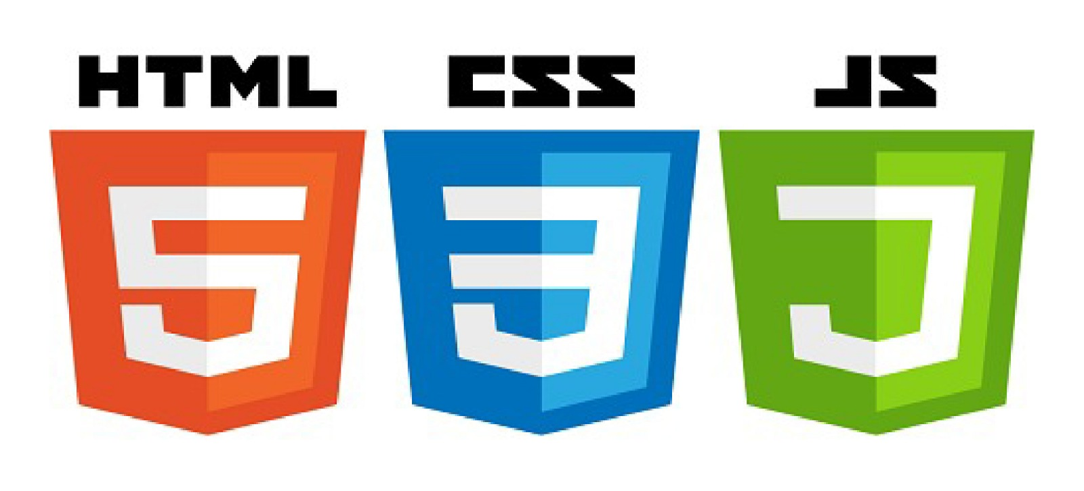
Front End
The web app is built using HTML, CSS, and JavaScript to ensure a responsive and interactive user experience.
The interface will feature dynamic visual elements and user-friendly navigation.

Slide 7

Data Sources
We will utilize various data sources, primarily from NASA's resources, including:
NASA’s APIs
NASA’s Small-Body Database
Approximate Positions of Planets

Slide 8
03
System Implementation

Slide 9
Time Control:
Users can manipulate time to observe celestial movements over different periods, enhancing the educational experience.
Orbital Propagation:
Our app employs orbital propagation techniques to calculate and display the positions of celestial bodies in real-time.
We process Keplerian parameters to ensure accurate orbital representations.
Keplerian Parameters:
Essential data such as eccentricity, semi-major axis, inclination, longitude of the ascending node, argument of periapsis, and true anomaly are used for computations.

Slide 10
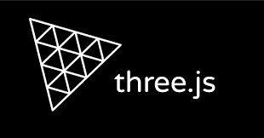
3D Visualization with Three.js:
We utilize Three.js to create visually appealing 3D representations of celestial bodies, including NEAs, NECs, and PHAs.
The 3D scene allows users to explore the solar system interactively.

Slide 11
04
Menu Bar

Slide 12
Trial timeline
Revolution Control
Day and Night Shades
Increase the revolution speed of celestial bodies to observe faster movements.
Real-time shading feature lets users visualize the solar system in day and night modes
02
04
03
01
Orbit Visualization Options
Search Functionality
05
search for specific planets, NECs, NEAs, and PHAs, or browse a comprehensive list of celestial objects.
toggle between viewing orbits and a simple visual representation of celestial bodies.
Conclusion

Slide 13
05
Conclusions

Slide 14
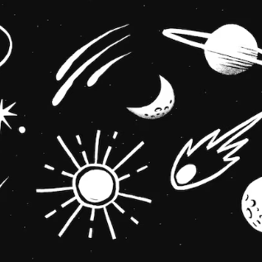
Conclusion
In conclusion, our interactive web app serves as an educational tool that brings the wonders of the universe closer to users. By visualizing celestial objects and their movements, we hope to inspire curiosity and a deeper understanding of astronomy. Thank you for your attention, and we look forward to any questions or feedback.

Slide 15
THANK YOU!

